Slide 1
RetailTech Executive Review Insights
Driving Business Value from Customer Review Data
Completed for Data Engineering Assignment 3
Paulina Thrasher

Slide 2
Executive Summary
Automated product categorization, sentiment analysis, and fake review detection completed.
Models drive labor savings, higher customer trust, and faster product launches.
Estimated ROI: 164%–192% with break-even in 5–7 months.

Slide 3
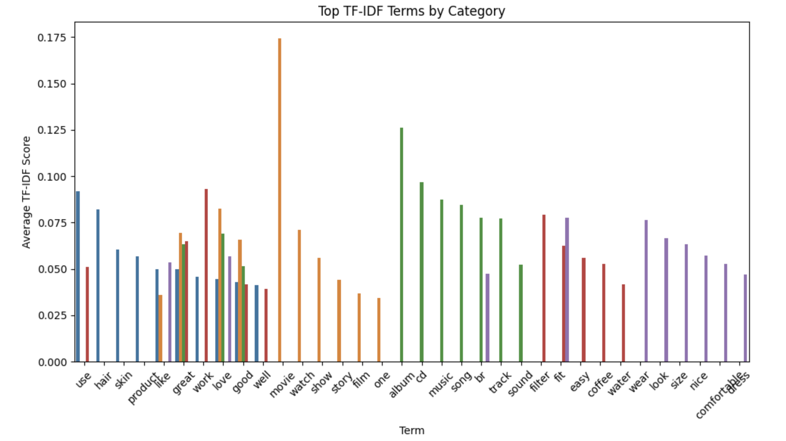
Key Insights – Product Categorization
87–88% model accuracy across categories.
CDs & Vinyl strongest category for predictability.
Beauty and Fashion overlap observed.

Slide 4
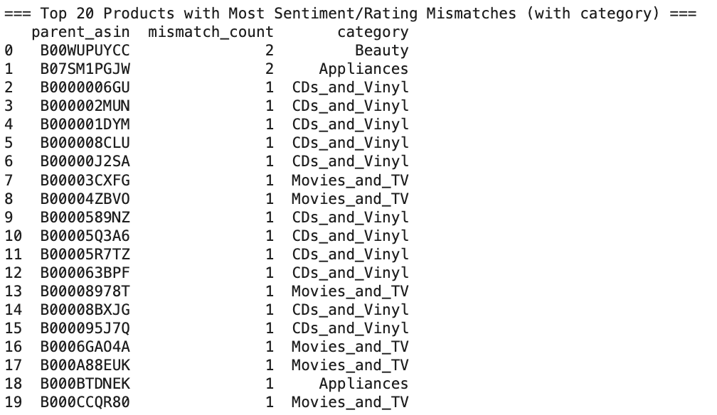
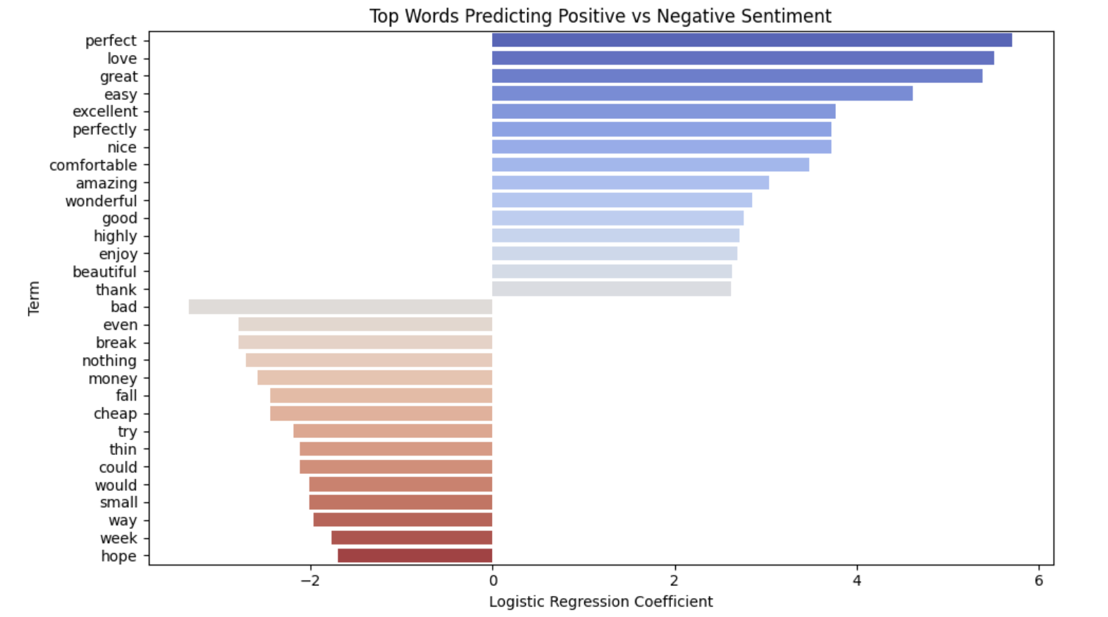
Key Insights – Sentiment Analysis
~52% ratings predicted within 0.5 stars.
Mismatch rate: 0.86% of reviews.
Emotional categories (Movies/TV, CDs & Vinyl) = more mismatches.

Slide 5
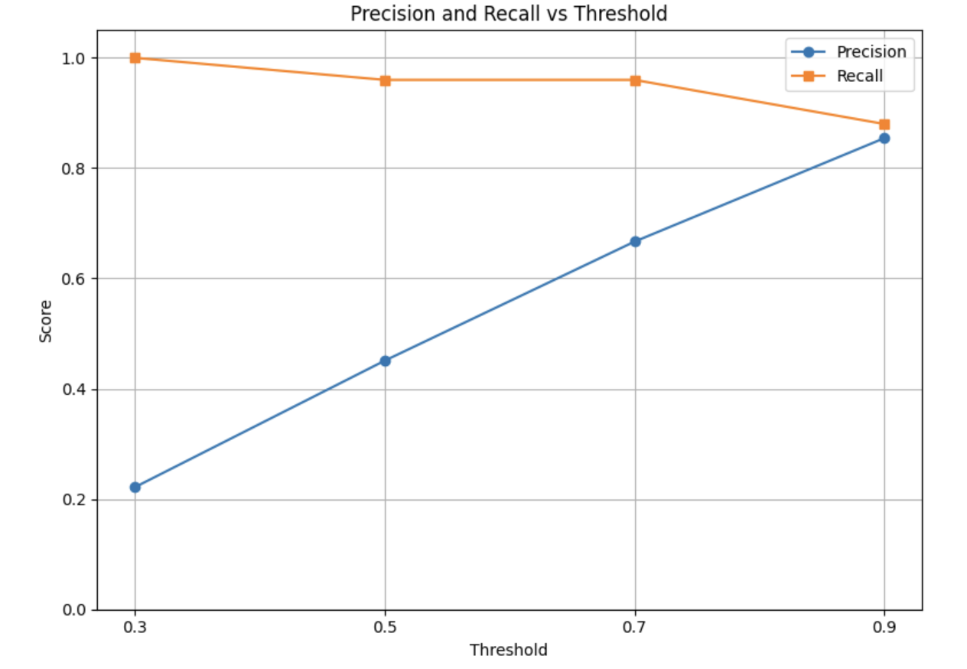
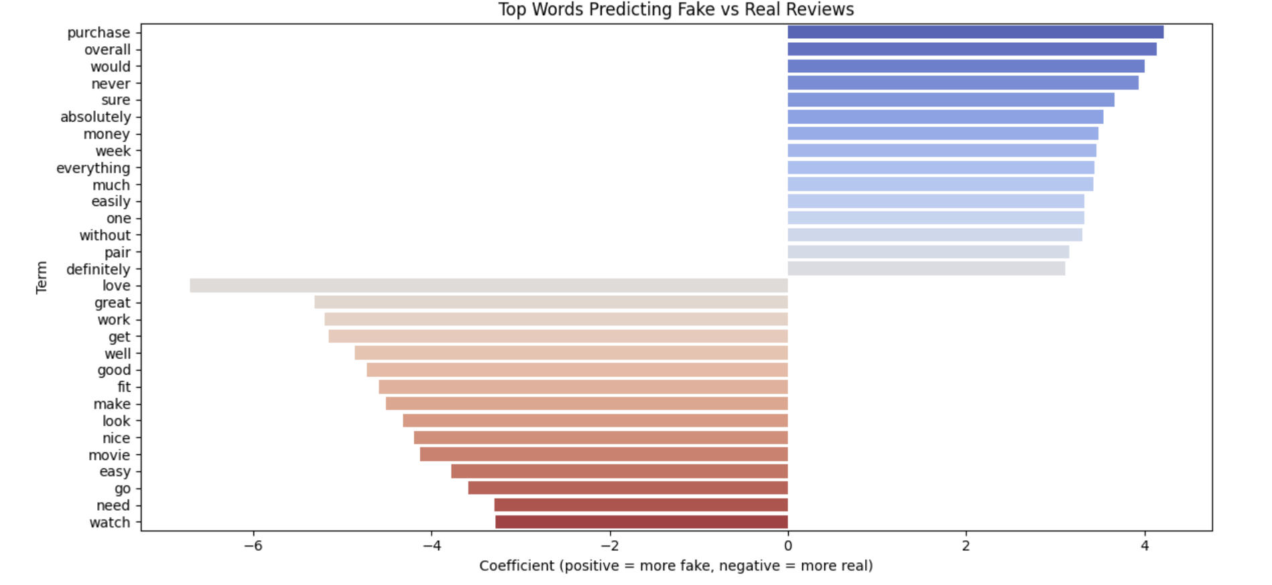
Key Insights – Fake Review Detection
Logistic Regression 97% accuracy.
Stricter thresholds improve precision significantly.
Fake reviews: generic/vague language patterns.

Slide 6
ROI and Break Even
Cost Component | Estimate | Notes
Initial Model Development | $0 (already completed)
Infrastructure (cloud hosting, storage, monitoring) | ~$500/month | AWS/GCP estimate for TF-IDF and Logistic Regression hosting.
Maintenance (model retraining and tuning) | ~20,000/year | 20% FTE Data Scientist for ongoing maintenance and monitoring.
Trust and Safety Manual Review (audit flagged reviews) | ~$10,000/year
0.1 FTE reviewer assuming 1–2 hours per week audit time.
Total | ~36,000/year
Benefit Component | Estimate | Notes
Labor Savings from Auto-tagging products | ~$50,000/year | Manual tagging (~10,000 products × $5 labor per product).
Labor Savings from Moderating Reviews | ~$30,000/year | Based on $50,000 baseline manual review cost, assuming ~60% automation.
Increased Customer Satisfaction (CSAT) | +1-2% | Better review trust = improved purchase confidence and loyalty.
Faster Product Onboarding | ~$15,000-20,000/year | Faster listing turnaround
Reduced Return Rates | TBD | More accurate sentiment matching -> fewer unhappy purchases.
Total | $95,000-100,00
Cost Estimates: $36k/year
Benefit Estimates: $95k–100k/year
Net Annual Gain: ~$59k–69k
Break-Even: 5–7 months.

Slide 7




Customer Segmentation Strategy
The Enthusiastic Reviewer
The Skeptical Shopper
The Trend Follower
The Disappointed Critic
Writes Long, positive reviews
Uses Emotional Language
Purchases across several categories
Recommends products to others
Leaves short reviews
More cautious about reviews
Typically rates items 3 stars
Leaves reviews on popular items
Frequently purchases things based on recommendations
Leaves reviews when they have a poor experience
Emotionally charged, negative reviews
High return rate
Switch brands more often

Slide 8
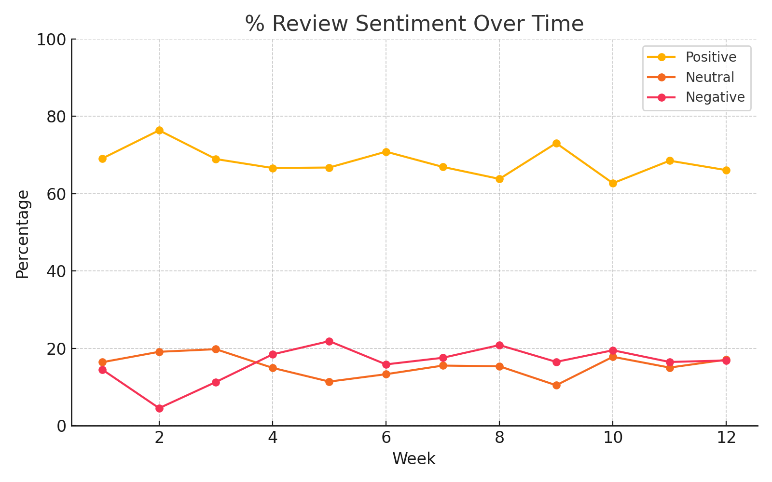
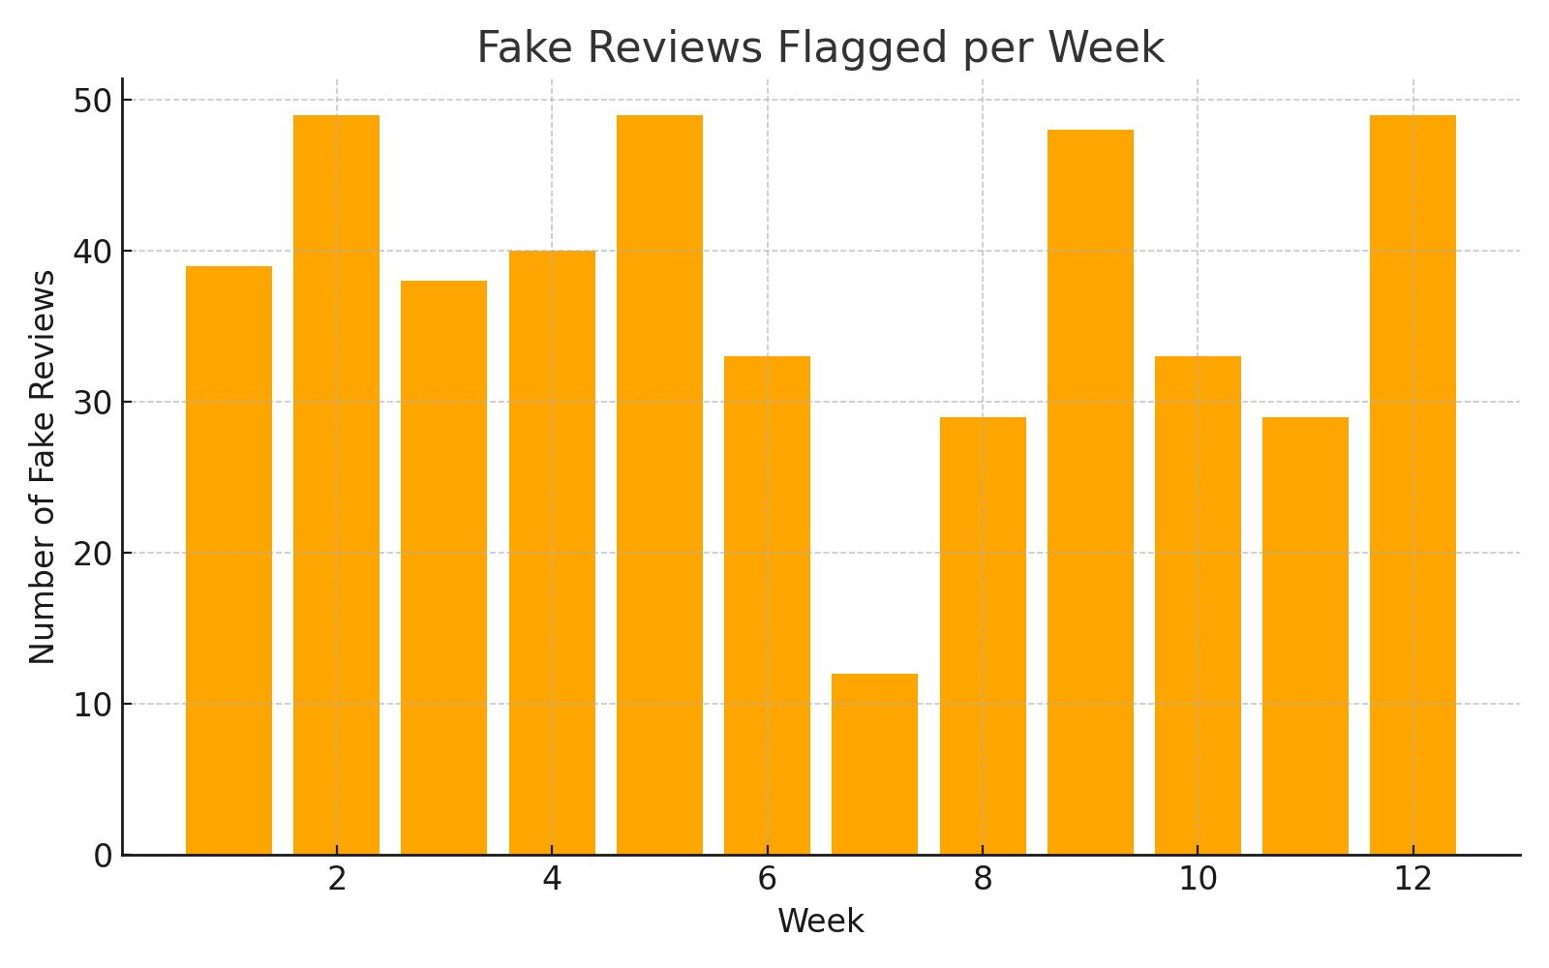
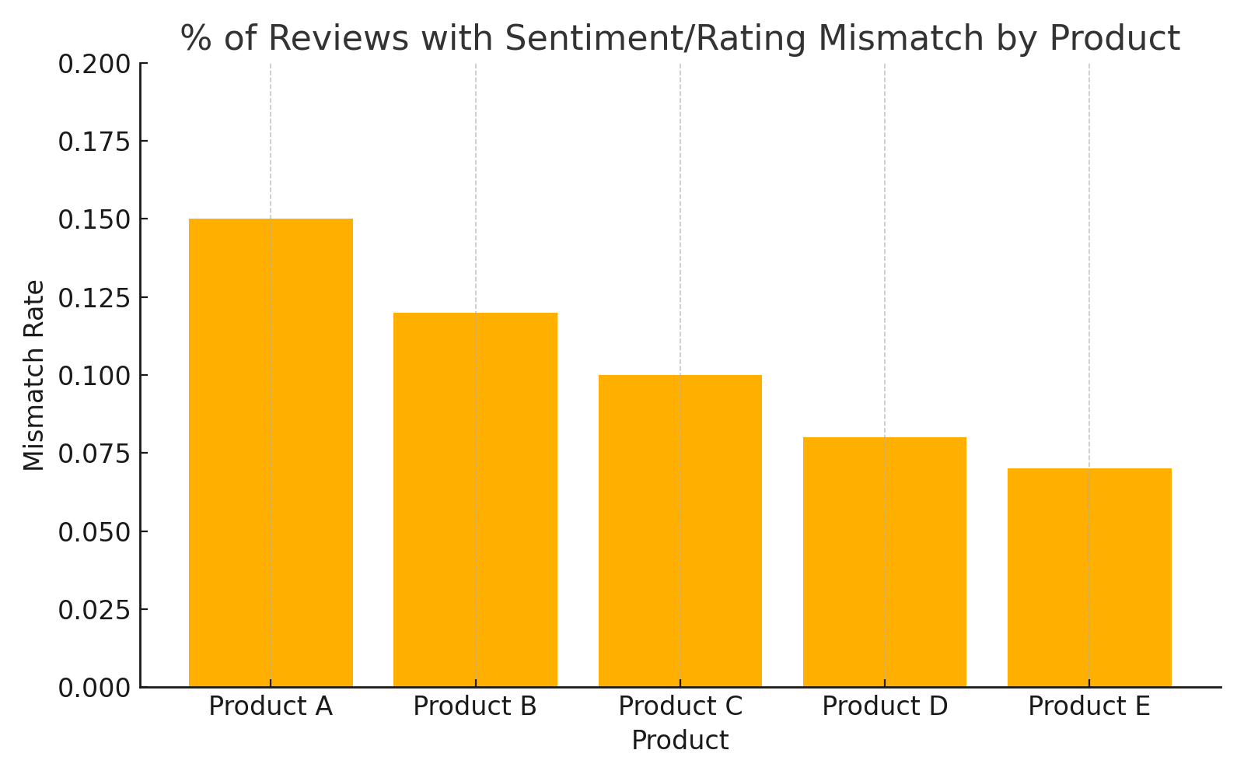
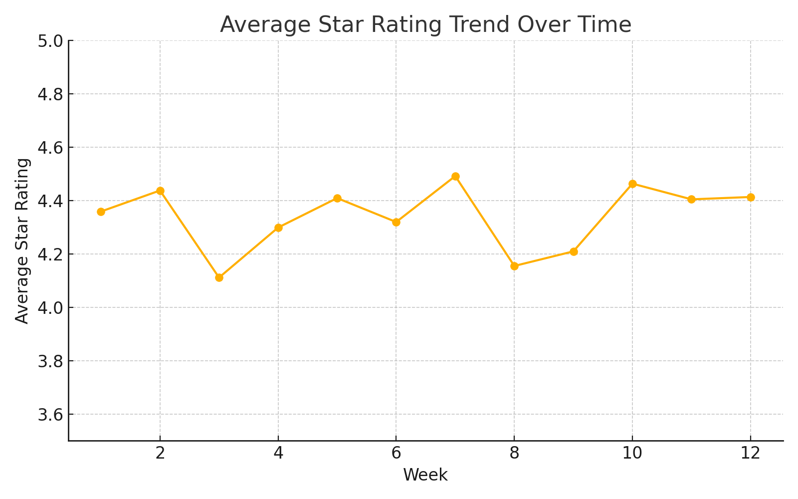
Review Monitoring Dashboard Mockup
Product Category | Product Name | Avg Star Rating | Avg Sentiment Score | % Sentiment/Rating Mismatch

Slide 9
Operational Recommendations
Auto-flagging suspicious reviews
Sentiment audit for marketing content
Emotional vs factual marketing by category
Real-time Customer Support escalations

Slide 10
Strategic Recommendations
Expand CDs & Vinyl offerings (strong brand affinity).
Improve Beauty product descriptions and visuals.
Launch curated gift collections (Fashion/Positive reviews).

